Slide 1
Chapter 3
Solving Problems by Searching

Slide 2
Search Algorithms Overview
Uniformed Search
No knowledge to guide to the goal
Uses knowledge to guide search
Informed Search

Slide 3
Uninformed vs. Informed Search
Uninformed (Blind) Search | Informed (Heuristic) Search
No extra information | Uses goal distance estimate
Explore blindly | Smarter and faster search
Example : BFS, DFS | Example : Greedy BFS, A*

Slide 4
Uninformed Search Algorithms
Breadth-First Search (BFS)
Definition: Explores all nodes at the current depth level before moving deeper to the next level.
Key Idea: Find the shallowest (closest) solution first.

Slide 5
Uninformed Search Algorithms
Breadth-First Search (BFS)
Pros: Complete (Guaranteed to find a solution if one exists. Won't get stuck in infinite paths)
Optimal (if step costs equal. Guarantees shortest path when all step costs are equal)
Cons: Very high memory usage.
Example : Searching for a friend on the 1st, then 2nd, then 3rd floor of a building.

Slide 6
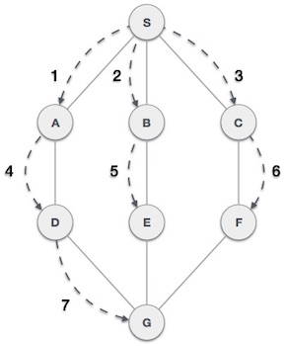
Breadth-First Search (BFS)
Start with the root node.
Check if it's the goal.
3. If not, add all its children to the queue.
4. Then dequeue the next node (from left to right), check it, and expand it by adding its children.
5. Repeat this process level by level.

Slide 7
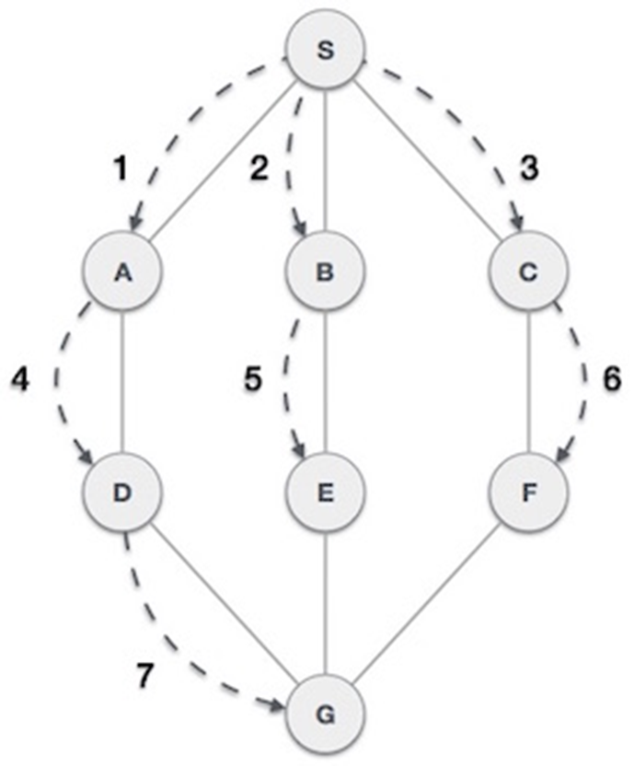
Breadth-First Search (BFS)
Queue : S
Queue: A B C
Queue: B C D
Queue: C D E
Queue: D E F
Queue: E F G
Queue: F G
Queue: G
Queue:

Slide 8
Uninformed Search Algorithms
Depth-First Search (DFS)
Definition: Explores as deep as possible along a branch before backtracking to explore other branches.
Key Idea: Dive deep into one branch, only backtrack if stuck.

Slide 9
Uninformed Search Algorithms
Depth-First Search (DFS)
Pros: Very low memory use.
Cons: Can get stuck in infinite paths (not complete), may not find the best solution (if the best in higher level-deep).
Example : Exploring a maze by always turning left first until you hit a dead end, then backtrack.

Slide 10
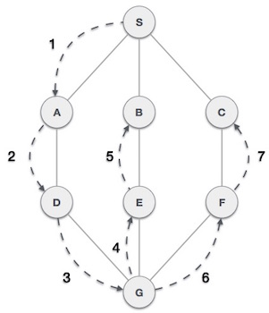
Depth-First Search (DFS)
1. Start from the root (or initial) node.
2. Check if the current node is the goal: - If yes → Return success.
3. If not: - Mark the current node as visited. - Pick one unvisited child of the current node and move to it (go deeper).
4. Repeat steps 2–3 for the new node.
5. If a node has no unvisited children, backtrack to its parent.
6. Continue this process until: - The goal is found → success. - Or all paths are explored and no goal is found → failure.

Slide 11
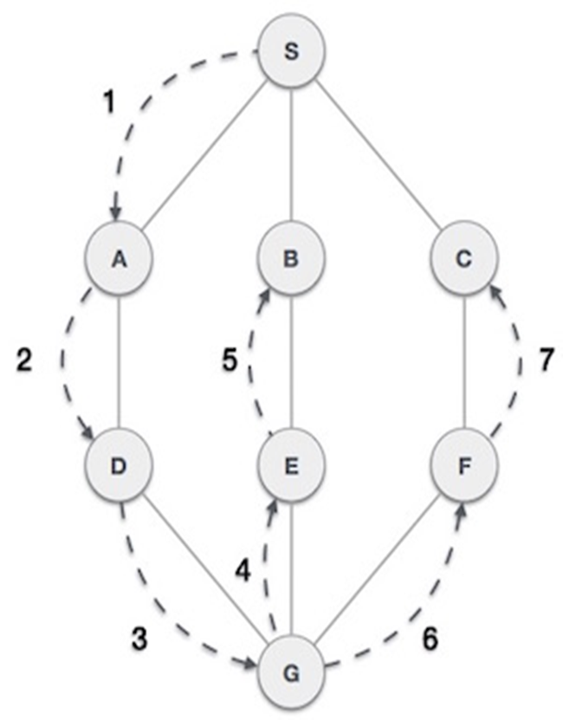
Depth-First Search (DFS)
Unvisited: S,A,B,C,D,E,F,G
Start from S
S is visited
A is unvisited
A is visited
D is unvisited
D is visited
G is unvisited
G is visited
E is Unvisited
E is visited
B is Unvisited
B is visited
Backtrack S (already visited)
Backtrack B
(already visited)
Backtrack E
(already visited)
Backtrack G
(already visited)
Backtrack F
Unvisited F
Visited F
Unvisited C
Visited C
S → A → D → G → E → B → F → C

Slide 12
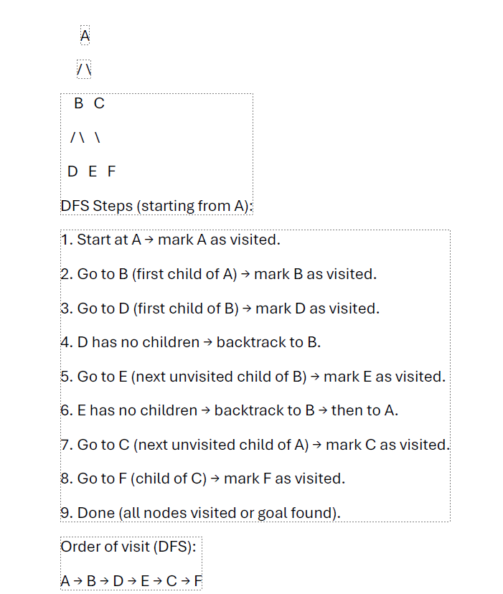
Depth-First Search (DFS)

Slide 13
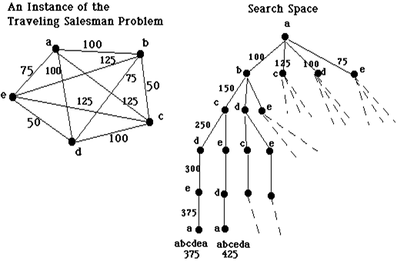
Notes
Example: The traveling salesman problem is too complex to be solved via exhaustive search for large values of N. The nearest neighbor heuristic work well most of the time, but with some arrangements of cities it does not find the shortest path. Consider the following two graphs. In the first, nearest neighbor will find the shortest path. In the second it does not:
A E D B C A 375

Slide 14
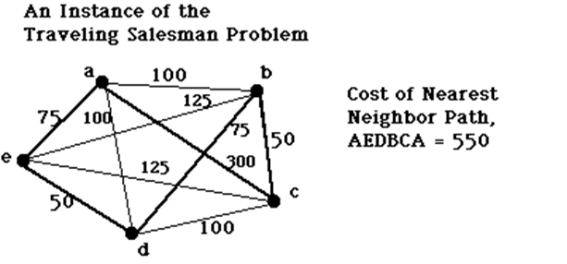
Notes
Check A E B C D A = 450 (The obtained one is not best path)

Slide 15
Informed (Heuristic) Search Algorithms
Greedy Best-First Search
Definition: Expands the node that appears closest to the goal, based only on the heuristic estimate (h(n)).
Key Idea: Always pick the node that looks most promising.

Slide 16
Best First Search Algorithm

Slide 17
Best First Search Algorithm

Slide 18
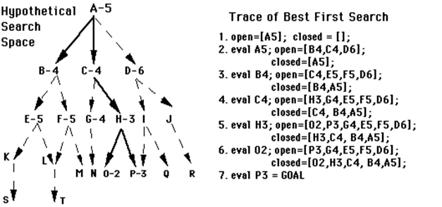
BFS Example

Slide 19
BFS: Priority Q usage
Concept:
A priority queue always removes the item with the lowest priority value first.
In heapq, smaller numbers = higher priority.
Example:
Let's say we want to add these items to a priority queue:
- ("task1", priority 3)
- ("task2", priority 1)
- ("task3", priority 2)

Slide 20
BFS: Priority Q usage
import heapq
#Create an empty priority queue
pq = []
#Push tasks with priorities
heapq.heappush(pq, (3, "task1")) # 3 PRIORITY, TASK1 DATA, pq the queue
heapq.heappush(pq, (1, "task2"))
heapq.heappush(pq, (2, "task3"))
#Now remove items one by one (will be sorted by priority)
while pq:
priority, task = heapq.heappop(pq)
print(f"{task} with priority {priority}")

Slide 21
BFS: Priority Q usage
Output:
task2 with priority 1
task3 with priority 2
task1 with priority 3

Slide 22
BFS Example
Heuristic values (h):- A: 5 - B: 4 - C: 3 - D: 2 - E: 6 - G: 0 (goal)
A:5
B:4 C:3 D:2
E:6 G:0

Slide 23
BFS algorithm
import heapq
#Define the graph as an adjacency list
graph = {
'A': ['B', 'C', 'D'],
'B': ['E'],
'C': [],
'D': ['G'],
'E': [],
'G': []
}
#Heuristic values for each node
heuristic = {
'A': 5,
'B': 4,
'C': 3,
'D': 2,
'E': 6,
'G': 0
}

Slide 24
BFS algorithm
def best_first_search(start, goal):
visited = set() # visited set
priority_queue = []
heapq.heappush(priority_queue, (heuristic[start], start)) # heuristic of A (5) , A ..(5,A) while priority_queue:
# h will receive the priority of the node, and node will receive the name of the node
h, node = heapq.heappop(priority_queue) # h is 5 and node is A, next h is 2 and node is D
if node in visited: # next h is 0 and node G
continue
print(f"Visited: {node}")
visited.add(node) # visited A, D visited G visited
if node == goal: # no, no yes
print("Goal reached!")
return
for neighbor in graph[node]: # graph [A] neighbor B,C,D, neighbor G
if neighbor not in visited: # B G
heapq.heappush(priority_queue, (heuristic[neighbor], neighbor)) #pushed( B:4,C:3,D:2) #Run the algorithm #pushed (G:0) the queue is (G:0, B:4,C:3)
best_first_search('A', 'G')

Slide 25
BFS algorithm
Visited: A
Visited: D
Visited: G
Goal reached!

Slide 26
Informed (Heuristic) Search Algorithms
Greedy Best-First Search
Pros: Fast and uses little memory.
Cons: Not guaranteed to find the best path (not optimal).

Slide 27
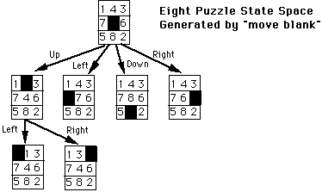
Informed (Heuristic) Search Algorithms

Slide 28
Informed (Heuristic) Search Algorithms
• Heuristic 1 (H1) : Count the out-of-place tiles, as compared to the goal. (small numbers are better)
• Heuristic 2 (H2): Sum the distances by which each tile is out of place. (small numbers are better)
• Heuristic 3 (H3): Multiply the number of required tile reversals by 2

Slide 29
Informed (Heuristic) Search Algorithms
Key Point: Developing good heuristics is a difficult, empirical (trial and error) process. The final measure of a heuristic's value is its actual performance on the search problem.
Weaknesses
• H1 (out-of-place) doesn't account for the distance that tiles have to move to get in place.
• H2 (Sum of distances) doesn't account for tile-reversals. It takes several moves to reverse two adjacent tiles.
• H3 often fails to distinguish between vastly different states.

Slide 30
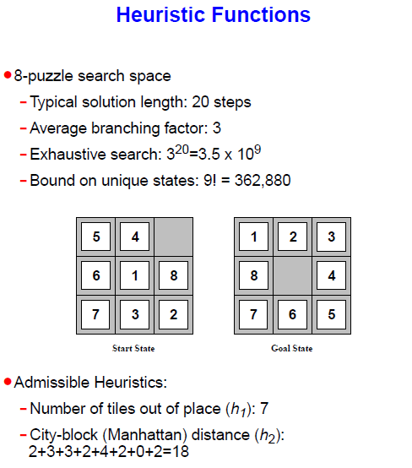
Informed (Heuristic) Search Algorithms

Slide 31
Admissible Heuristic Function
A heuristic function is said to be admissible if it never overestimates the cost of reaching the goal, i.e. the cost it estimates to reach the goal is not higher than the lowest possible cost from the current point in the path (gives the perfect answer).

Slide 32
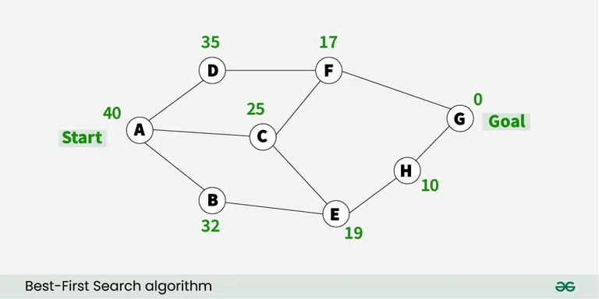
Greedy Best-First Search

Slide 33
Informed (Heuristic) Search Algorithms
A* Search
Definition: Expands the node with the lowest total estimated cost: actual cost so far (g(n)) + estimated cost to goal (h(n)).
Key Idea: Balance between exploring cheapest known paths and promising unknown paths.

Slide 34
A* algorithm
procedure A_star_search {
open := [Start]; % Initialize
closed := [];
assign g(Start) := 0;
assign f(Start) := g(Start) + heuristic(Start);
while open != [] do { % While states remain
remove the leftmost state from open, call it X;
if X = goal then return path from Start to X;
else {
generate children of X;

Slide 35
for each child of X do {
case {
the child is not on open or closed: {
assign g(child) := g(X) + cost(X, child);
assign f(child) := g(child) + heuristic(child);
add the child to open;
}
the child is already on open: {
if this child was reached by a shorter path {
assign g(child) := g(X) + cost(X, child);
assign f(child) := g(child) + heuristic(child);
reorder child on open by f value;
}
}
the child is already on closed: {
if this child was reached by a shorter path {
remove the state from closed;
assign g(child) := g(X) + cost(X, child);
assign f(child) := g(child) + heuristic(child);
add this child to open;
}
}
}
}, % cases

Slide 36
put X on closed;
re-order states on open by f value (lowest first);
} % else
} % while
return failure % open is empty
} % A_star

Slide 37
A* Example
Example Graph: We want to go from Start (S) to Goal (G).
Nodes: S, A, B, C, D, G
Edges & Costs:S - A (1)
S - B (4)
A - C (2)
B - D (5)
C - G (3)
D - G (1)
Heuristic h(n) (estimated cost to G):
S = 7, A = 6, B = 5, C = 2, D = 1, G = 0
f(n) = g(n) + h(n)

Slide 38
A* Example
Step 0: - Start at S
- g(S) = 0, h(S) = 7 → f(S) = 7
- Open: [S(0+7=7)] - Closed: []
Step 1:
- Pop S from Open → move to Closed
- Neighbors: A(g=1), B(g=4)
- f(A) = 1 + 6 = 7
- f(B) = 4 + 5 = 9 `
- Open: [A(7), B(9)]
- Closed: [S]

Slide 39
A* Example
Step 2:
- Pop A (lowest f=7)
- Neighbors: C(g=1+2=3)
- f(C) = 3 + 2 = 5
- Open: [C(5), B(9)]
- Closed: [S, A]
Step 3:
- Pop C (lowest f=5)
- Neighbors: G(g=3+3=6)
- f(G) = 6 + 0 = 6
- Open: [G(6), B(9)]
- Closed: [S, A, C]

Slide 40
A* algorithm
Step 4:
- Pop G → Goal Reached!
- Total cost = 6,
Path: S → A → C → G
- Open: [B(9)]
- Closed: [S, A, C, G]

Slide 41
Informed (Heuristic) Search Algorithms
A* Search
Pros: Complete, Optimal (if heuristic is admissible)
Cons: High memory usage.
Example : Choosing a path based on how much you have already walked + how far you think is left.

Slide 42
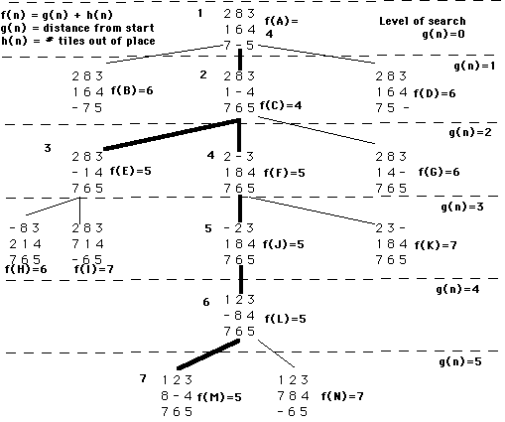

Slide 43
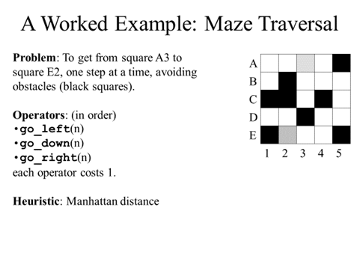
A* Example

Slide 44
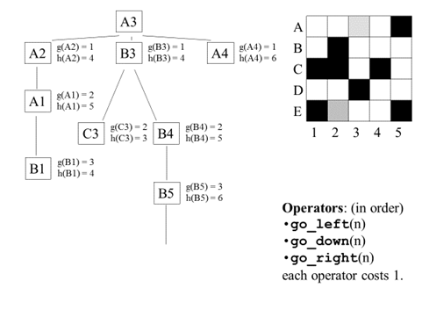
A* Example

Slide 45
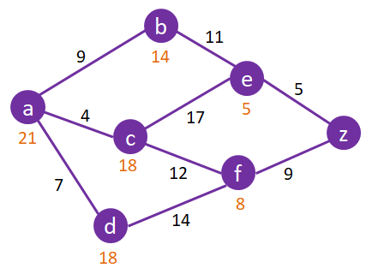
A* Search Exercise

Slide 46
BFS versus A* in terms of App.
Best First Search: (When you do not care about finding the optimum solution path, but cares more on finding a solution quickly. Can be used in AI game that needs real time decisions)
A*: (It Balances between exploring quickly and finding the optimal path, guaranteeing the lowest-cost solution when the heuristic is well-designed.)
Note: In general, if you need efficiency and optimality, go with A*. If you need speed and don't care about the cost, best-first search can be more suitable.

Slide 47
Problems that might appear with A*
h' underestimates h : You're underestimating “when it's (the heuristic) lower than the actual final path cost”
going deep in certain direction, then go back to the right direction. It finds the optimum solution.
f(n)=h(n)+g(n) f(n) < actual cost to goal (for underestimate)
f(n) <= actual cost (admissible function)

Slide 48
Problems that might appear with A* (underestimates)

Slide 49
Problems that might appear with A*
h' overestimates h: You are overestimating when the heuristic's estimate is higher than the actual final path cost. f(n) > actual cost
We do not find the optimum solution

Slide 50
AO* Algorithm
It is used for a problem that can be decomposed. This algorithm is used in AND-OR graph whereas the A* algorithm is used in OR graphs. One example of AND-OR graph is the integration problem, another example is the parse tree in natural language processing (see the class notes). In AO* algorithm, we have only one list called GRAPH. To search an implicit AND-OR graph, it is necessary to do three things each step :

Slide 51
AO* algorithm
1. Traverse the graph, starting at the initial node and following the current best path and accumulate the set of nodes that are on that path and have not yet been expanded.
2. Pick one of these unexpanded nodes and expand it. Add its successors to the graph and complete f' (using only h' and ignoring g ).
3. Change f' estimate of the newly expanded node to reflect the new information provided by its successors. Propagate this change backward through the graph. At each node that is visited while going up the graph, decide which of its successors arcs is the most promising and mark it as part of the current best path.

Slide 52
AO* algorithm

Slide 53
AO* algorithm
There are main differences between A* and AO*
2. In A*, the desired path from one node to another was always the one with the lowest cost, but this is not always the case when searching an AND-OR graph.
3. Consider the example shown in the figure below:

Slide 54
AO* algorithm
Despite the path through 10 to 5 is longer, but it should be followed because node four is unsolvable which means a solution through path 3 and 4 can not be reachable.
3.In AO* there is no OPEN and CLOSE lists, we have only Graph list G.
4.In AO*, g is not used because the longer path might be better (g is not becoming an important issue).

Slide 55
Some of AND-OR graph examples
Integration problem

Slide 56
Some of AND-OR graph examples
NLP

Slide 57
Some of AND-OR graph examples

Slide 58
sentence --> noun_phrase, verb_phrase.
% 2. A noun phrase is a noun
noun_phrase --> noun.
% 3. A noun phrase is an article followed by a noun
noun_phrase --> article, noun.
% 4. A verb phrase is a verb
verb_phrase --> verb.
% 5. A verb phrase is a verb followed by a noun phrase
verb_phrase --> verb, noun_phrase.
% ----------- Terminals -----------
% 6. Articles
article --> [a].
article --> [the].
% 7. Nouns
noun --> [man].
noun --> [dog].
% 8. Verbs
verb --> [likes].
verb --> [bites].

Slide 59
Goals
?- sentence([the, dog, bites, a, man], []).
?- sentence([a, man, likes, dog], [])
?- sentence([dog, likes, the, man], []).
?- sentence([the, dog, runs], []).
Generating sentences:
sentence(S, []).

Slide 60
% Entry point: an utterance is a sentence that consumes the entire list
utterance(X) :- sentence(X, []).
% A sentence consists of a noun phrase followed by a verb phrase
sentence(Start, End) :- nounphrase(Start, Rest), verbphrase(Rest, End).
% A noun phrase can be a single noun
nounphrase([Noun|End], End) :- noun(Noun).
% Or an article followed by a noun
nounphrase([Article, Noun|End], End) :- article(Article), noun(Noun).
% A verb phrase can be a single verb
verbphrase([Verb|End], End) :- verb(Verb).
% Or a verb followed by a noun phrase
verbphrase([Verb|Rest], End) :- verb(Verb), nounphrase(Rest, End).
% Lexicon
article(a).
article(the).
noun(man).
noun(dog).
verb(likes).
verb(bites).

Slide 61
Some of AND-OR graph examples
Goals:
utterance([the, dog, bites, the, man]).
utterance([ dog, bites, man]).
utterance([ bites, dog, man]).

